Slide 1
Number Guessing Game
Team members- Manichand 2010030455
Dileep -2010030416
Harsha -2010030173
Prakash- 2010030533

Slide 2
ABSTARCT
The Guessing Game on numbers {0, ..., N} and non negative parameter α ≤ 1 is considered in a 1-shot setting with k levels of thinking. The model proposed is based on two assumptions:
1.) Players consider intervals rather than numbers, parametrized by a non negative parameter ², called the confidence parameter;
2.) Each player readjusts her guess successively during the sequence of iterations according to her recent belief. Under mild conditions.

Slide 3
INTRODUCTION
One of the simplest two-player games is “Guess the number”. The first player thinks of a secret numberin some known range while the second player attempts to guess the number. After each guess, the firstplayer answers either “Higher”, “Lower” or “Correct!” depending on whether the secret number is
higher, lower or equal to the guess. In this project, you will build a simple interactive program in Pythonwhere the computer will take the role of the first player while you play as the second player.

Slide 4
Literature review
First, the thesis written by Zahro (2013) untitled “ The Effect of Guessing Games On The eight Year Students’ Vocabulary Achievement at SMPN 03 Balung Jember In The 2012/2013 Academic Year”. The form of this research is quasi experimental with emphasizing at the game to solve the teachers’ problem in teaching vocabulary. This thesis concern about how effect of guessing game on students’ vocabulary achievement at SMPN 03 Balung Jember in the 2012/2013 academic year. Guessing games is a significant effect on the eight year students’ vocabulary achievement.
Second, the thesis written by Safitri, Wijaya, & Husin (2016) untitled “The Effectiveness Of Guessing Game Towards Students’Writing Skill On Descriptive Text”. This thesis concern about the effectiveness of the use of Guessing game in students’ writing skill on descriptive text.. According this article, guessing game is effective and very strong to improve the students’ writing skill on descriptive text to the seventh grade students of MTs N 01 Pontianak in academic year 2014/2015. 7

Slide 5
Literature review
Third, the thesis written by Zahara & Fatimah (2018) untitled “ Using Guessing Game in Teaching Writing Descriptive texts to Junior High School”. This article concern about the usage of guessing game in teaching writing, especially descriptive text. According this thesis, guessing game helps English teacher to create an enjoyable atmosphere in the classroom and the process of teaching and learning can be more interesting for students. the students are also expected to develop ideas from their activity easier.
fourth, the thesis written by Anggreyni (2014) untitled “Improving Students’ Speaking Skill Through Guessing Game Technique At Grade X-1 Of SMA Negeri Angkola Selatan Tapanuli Selatan”. This thesis concern about classroom action research in which researcher applied guessing game technique on improving the effectiveness of teaching speaking skill at grade X-1 of SMA Negeri angkola Selatan Tapanuli Selatan. Based on this article, guessing game technique better improves the students’ speaking skill at the grade X-1 of SMA Negeri 1 Angkola Selatan Tapanuli Selatan, and the factors that influence the changes of students’ speaking skill are students’ motivation, students’ confidence and group discussion

Slide 6
Working Methods
This script is an interactive guessing game, which will ask the user to guess a number between 1 and 99.
.so now when user inputs a number and runs it with using while loop the loop gets started and user needs guess correct number until then the loop wont stop until we stop
In this there is no number of attempts user can play until guessed correct number

Slide 7
Changes for game
We could make it more complex by getting the computer to count the guesses until the person guesses the right number and using some different frame works we will work
Tools
Predefined modules
Random package,other packages
Software
Pycharm , VS code

Slide 8
RESULT –
we founded result that by using the python language we can build this project and modify it
We are using the random module with the function to get a random number. The script also contains a while loop, which make the script run until the user guess the right number

Slide 9
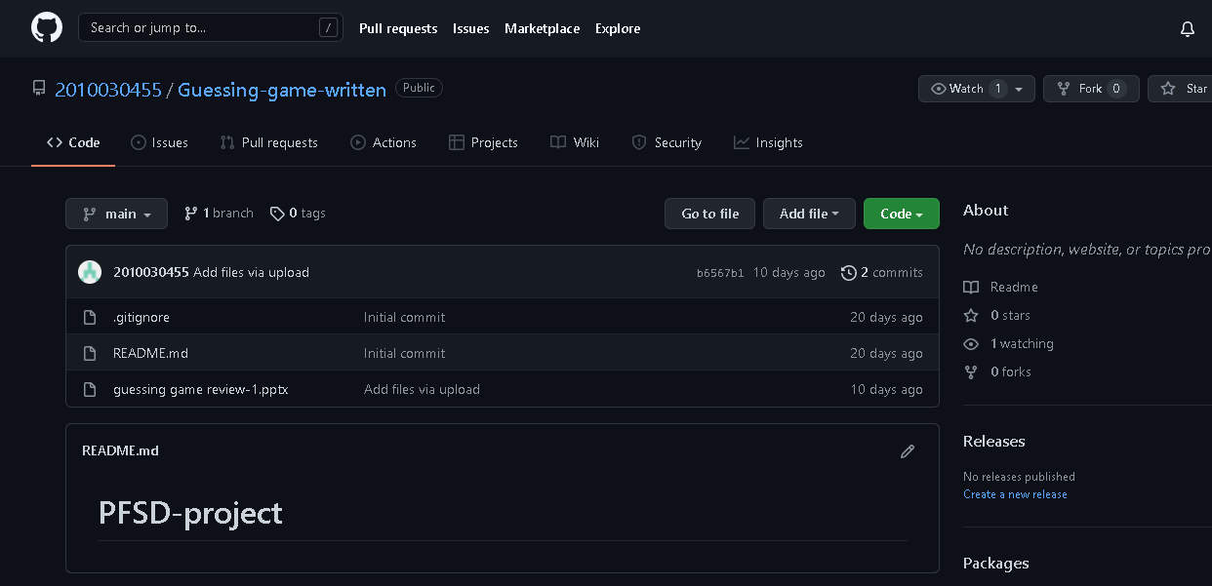
Github commits

Slide 10
Work progress
So our project is about number guessing until now we have done upto basic alpha testing and github commits
Manichand – writing code and using flask and implementing
Harsha – searching for algorithms which are close to project
Dileep - searching for packages and testing the code
Prakash – testing the code and implementing in application and like website

Slide 11
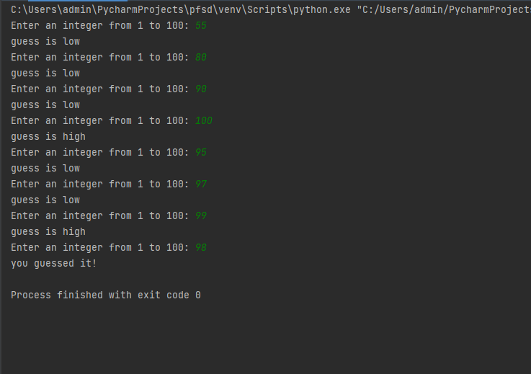
Alpha testing

Slide 12
START
Genarate random integer between 1 and 100
Input guess number
Guess==
random
Guess
>
random
NO
YES
Print “Guess is too high”
Input guess
YES
NO
Print “guess is right you win!”
Print”guess is too Low”
END

Slide 13
Conclusion
We want to conculed is if your guess was too high or too low and if your guess was right it told you that also. It had a limit between 1-100 so that it wasn’t too hard for people to guess. As well as this not the final we should work on more to modify the code and give better output

Slide 14
THANK
YOU

